Slide 1
The PokeProject
Megan Barrera, zeeshan bhimji, van dang, Dave shilander
WHO DAT POKEMON!!??

Slide 2


Notes:
Have you ever thought of a pokemon but couldn’t remember its name? Introducing…….

Slide 3
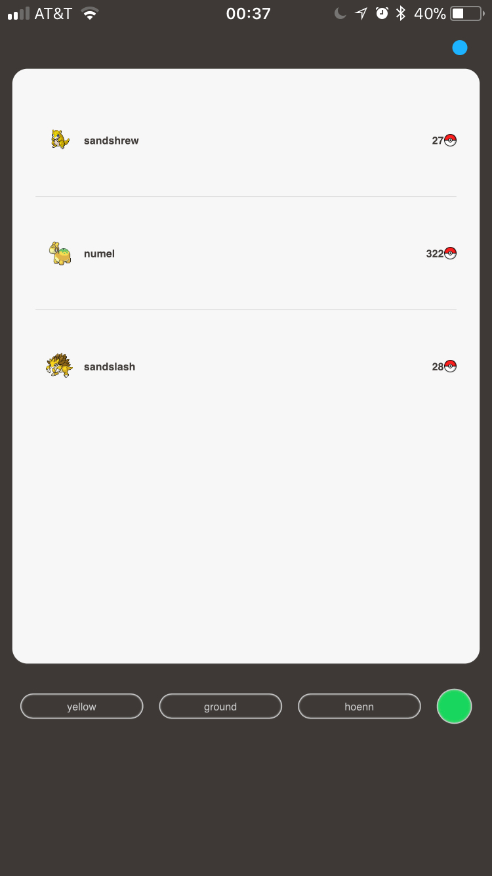
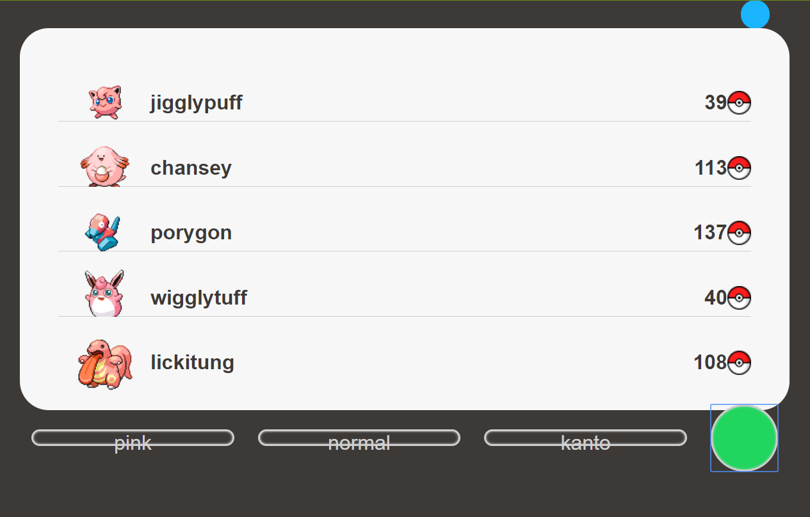

Slide 4
concept
Pokedex… with gifs!!!!!
Can’t think of a pokemon’s name? Use our app!
Basically a Pokemon search engine

Slide 5
motivation
Open API
Van loves Pokemon. So does 98% of the world
Zee knows nothing so we have to educate him
Notes:
Socially conscious app that reduces stress and gives peace of mind

Slide 6
Design process
Pokedex- used for inspiration
Front-end challenges
Back-end challenges
Notes:
(stuff that worked and didn’t) /// (why changes were made)
((buttons vs search fields))
(backend validation)

Slide 7
Challenges
Google Map Markers
Modals
Firebase user login saved history

Slide 8
Technologies used
HTML5
CSS3
SASS
Javascript/jQuery
PokeAPI
Underscore.js
Giphy API

Slide 9
The final product
https://raptorcentauri.github.io/CharlieProject/

Slide 10
Future development
API Speed
Desktop version
More search fields/filters
Add description of Pokemon
Incorporating Pokemon Go
Location tags
Guides to catch Pokemon
User login
Other than that… it’s perfect!!!!!!!!!!!!!!!!! A+++

